Slide 1



ONE ANASTOMOSIS GASTRIC BYPASS – THE FIRST PROCEDURE IN ISRAEL
Adam Abu-Abeid M.D
Consultant Surgeon, Tel Aviv Sourasky Medical Center
Assistant Professor, Faculty of Medical Health and Sciences, Tel Aviv University

Slide 2

CONFLICT OF INTERESTS
None

Slide 3




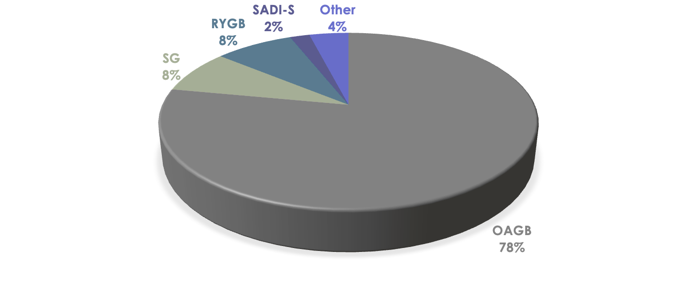
CASE MIX DISCLOSURE
Revisional cases – 18%

Slide 4


OAGB - HISTORY
First described by Robert Rutledge in 1997
Modified by Carabajo in 2005
“Dark years”
First IFSO consensus statement in Hamburg, 2019
ASMBS consensus statement in 2024
Luque-de-León E et al. One Anastomosis Gastric Bypass (OAGB): the Story Behind a Name with 20 Years of History. Obes Surg. 2023

Slide 5
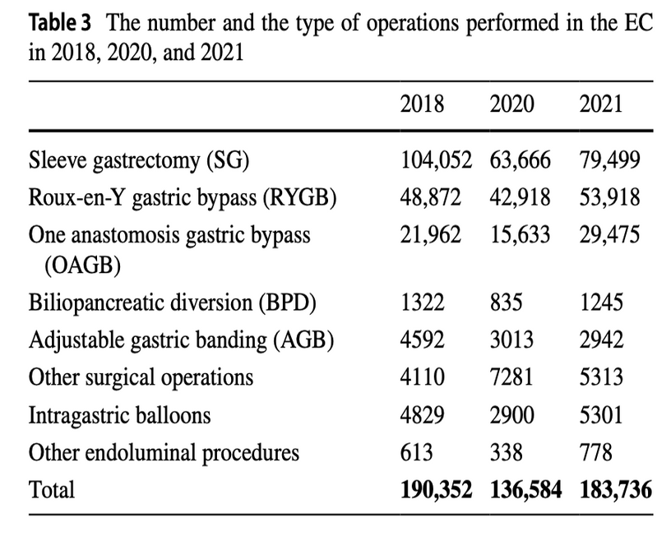
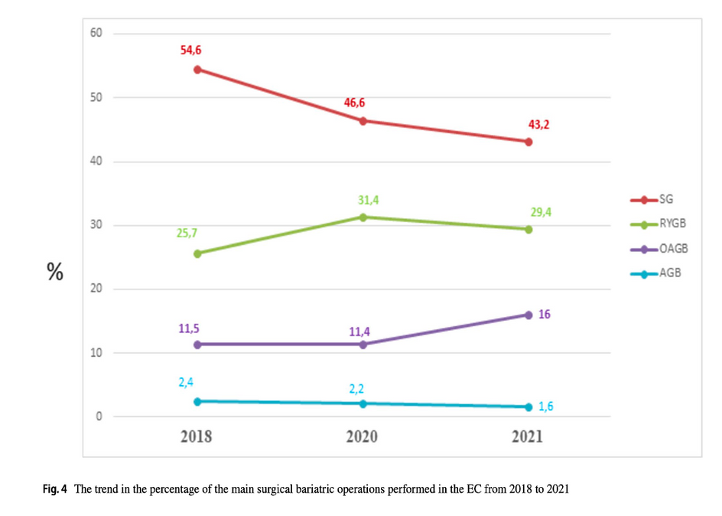
OAGB TRENDS IN IFSO-EC
Angrisani L et al. IFSO Worldwide Survey 2020-2021: Current Trends for Bariatric and Metabolic Procedures. Obes Surg. 2024.

Slide 6
Israel National Bariatric Registry

Slide 7

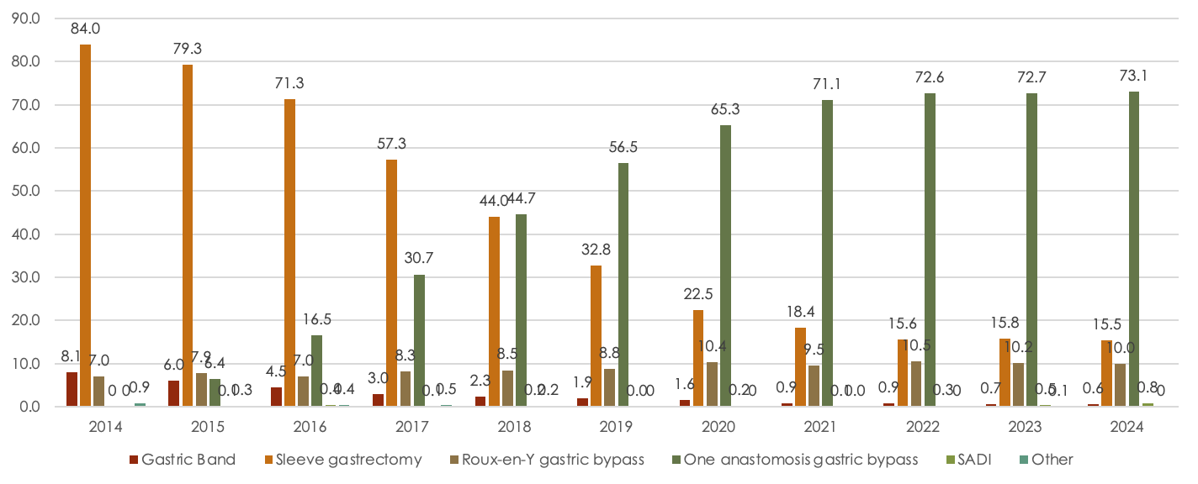
MBS TRENDS IN ISRAEL - PRIMARY
Israel National Bariatric Registry

Slide 8
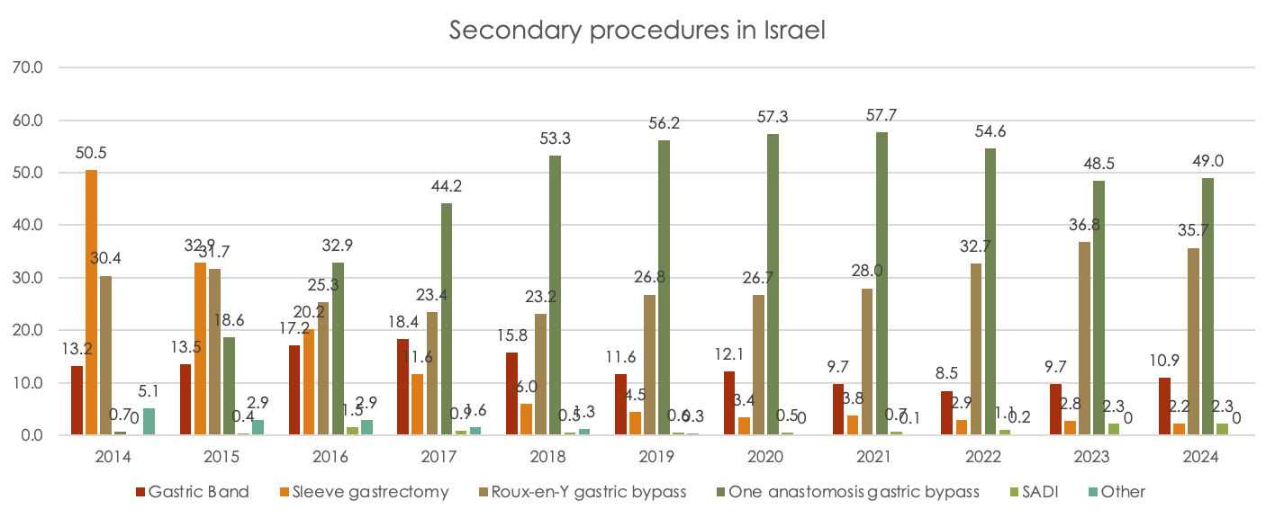
MBS TRENDS IN ISRAEL - REVISIONAL
Israel National Bariatric Registry

Slide 9
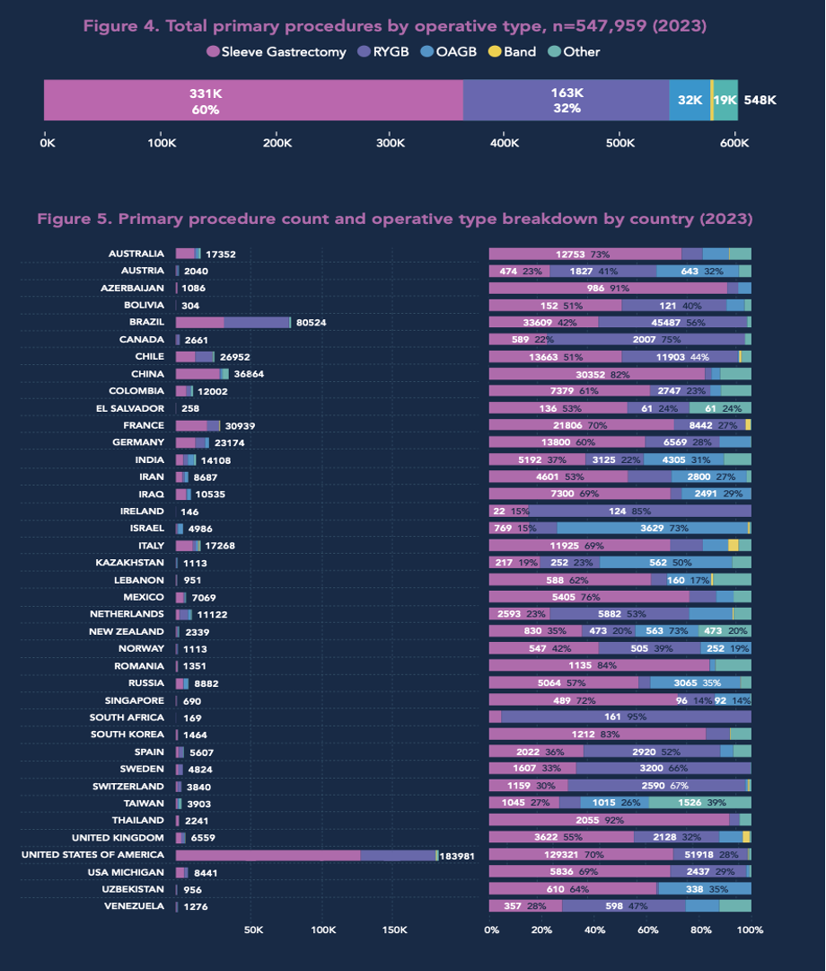
9th IFSO Global Registry

Slide 10
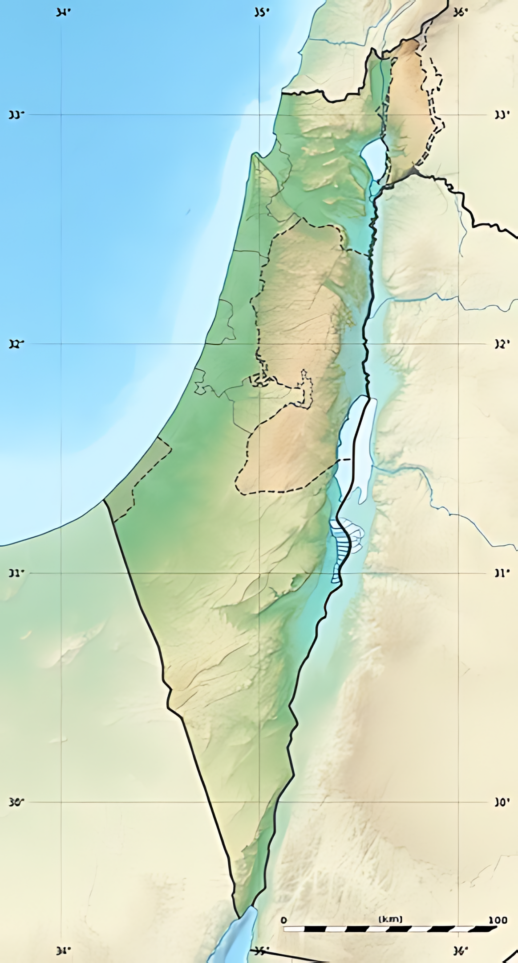

ISRAEL DEMOGRAPHICS
Population ~ 10 million
Jews – 74%
Muslim Arabs – 21%
Christian Arabs – ~ 2%
Druze - ~ 2.5%
Other – Circassians, Baha’ians
Everyone knows everyone….

Slide 11
REASONS WHY OAGB IS THE FIRST PROCEDURE IN ISRAEL
Safety long-term
Better outcomes
Patient satisfaction
Small country
Cost
Tailoring
Durability
Effectiveness
Reversibility
Israeli studies
Safety short term
Technical procedure

Slide 12

SAFETY

Slide 13
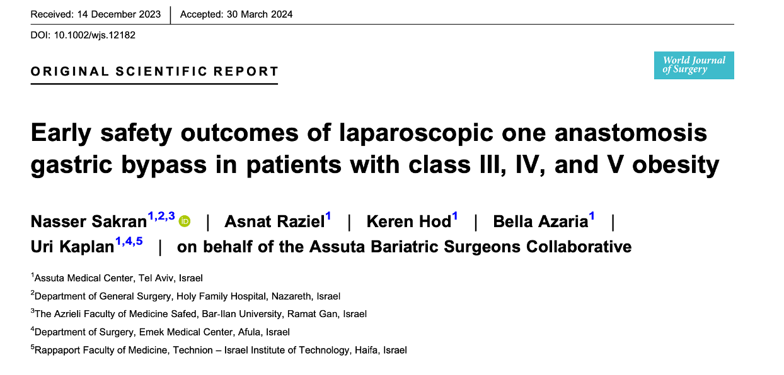
SAFETY
Cohort analysis
Assuta private medical center
Between January 2017–December 2021
3229 patients
Study aim was to assess 30-day OAGB safety in different obesity grades

Slide 14
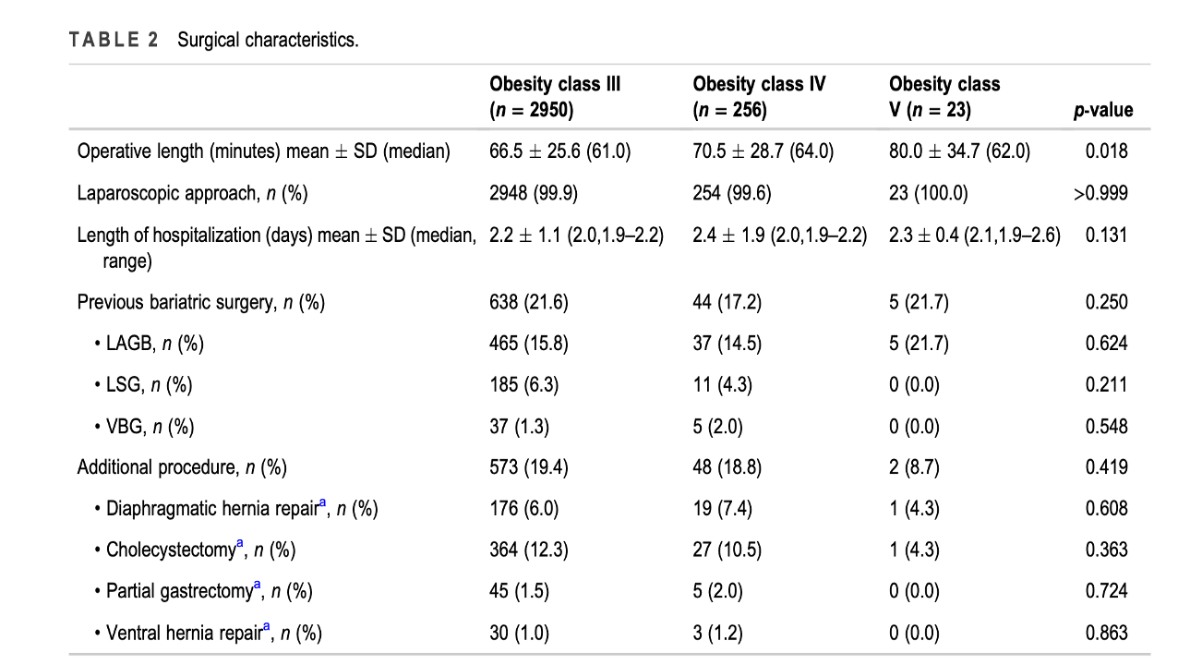
Sakran N et al. Early safety outcomes of laparoscopic one anastomosis gastric bypass in patients with class III, IV, and V obesity. World J Surg.

Slide 15
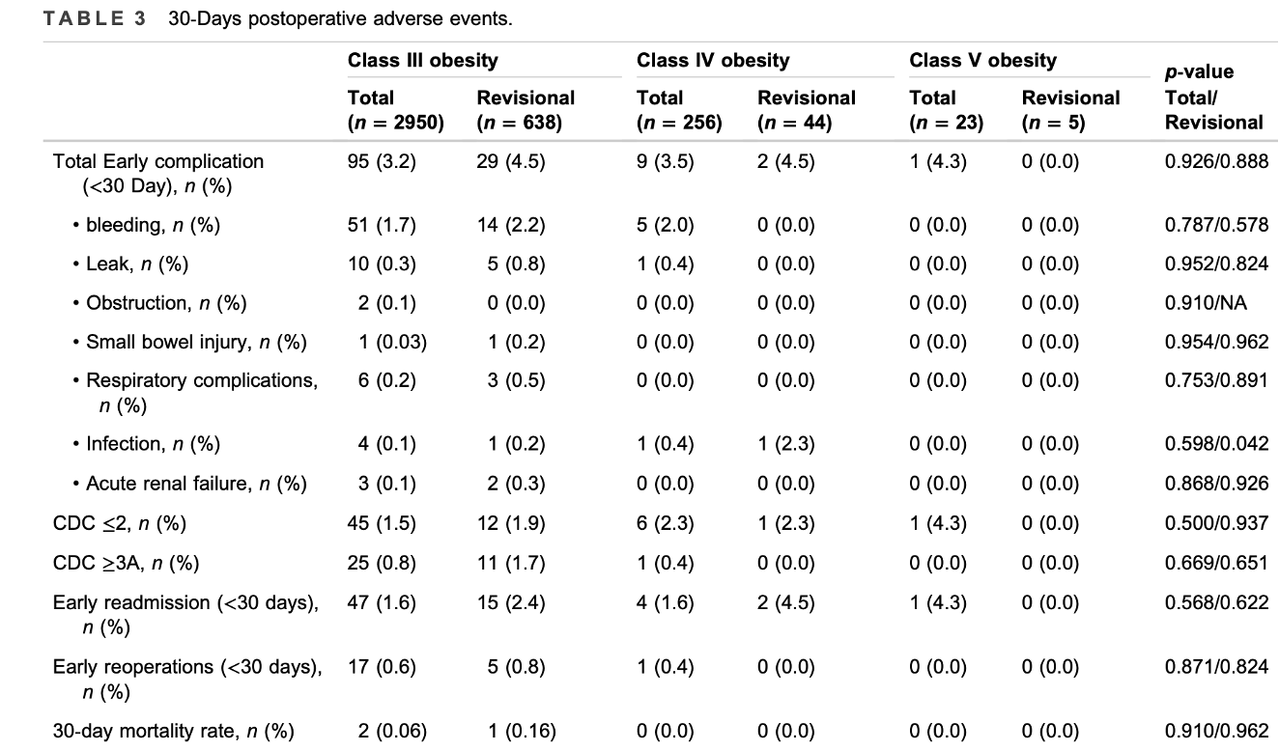
Sakran N et al. Early safety outcomes of laparoscopic one anastomosis gastric bypass in patients with class III, IV, and V obesity. World J Surg.

Slide 16
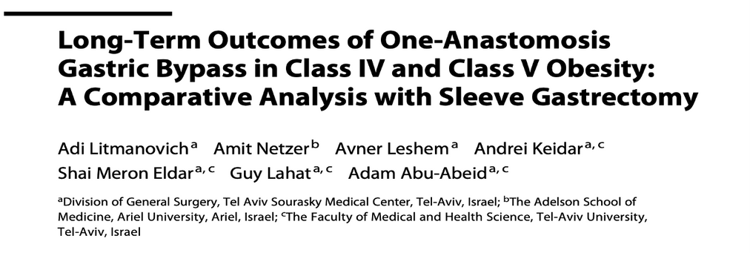
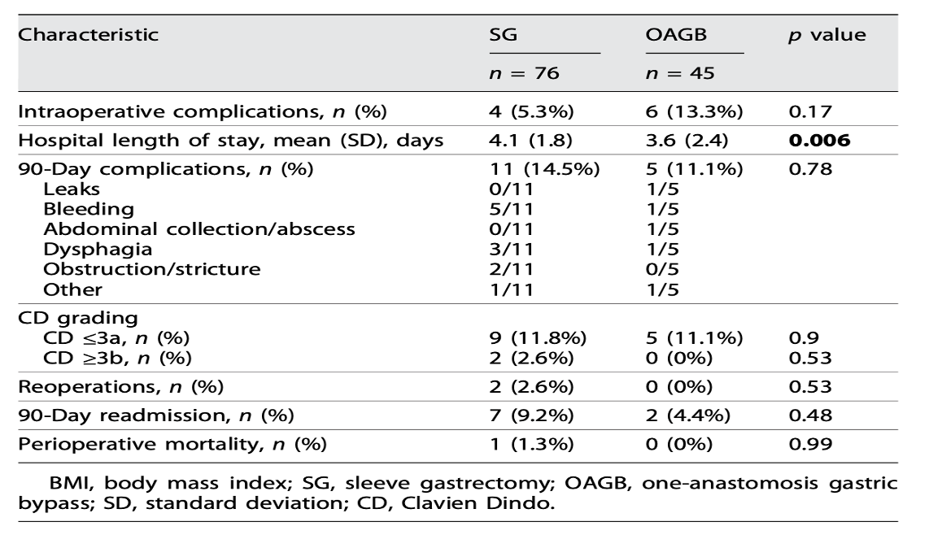
Obesity facts, 2025

Slide 17

TECHNICAL CONSIDERATIONS

Slide 18
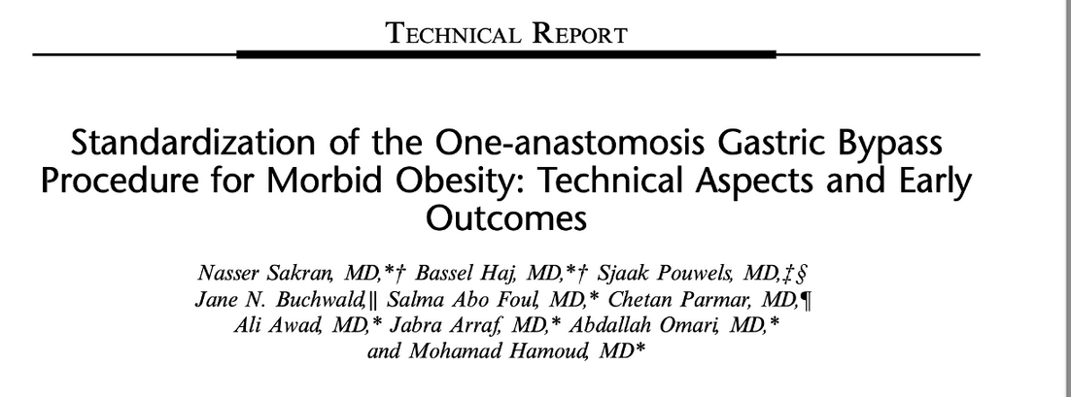
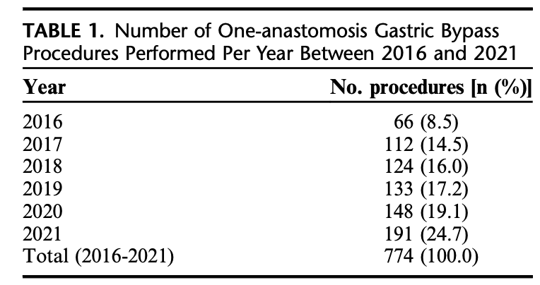
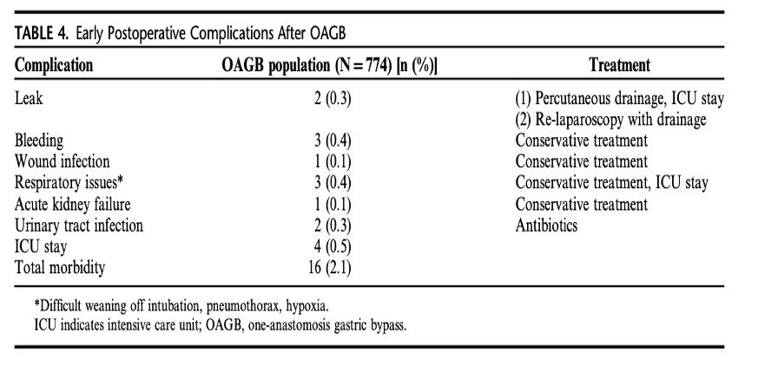

Slide 19
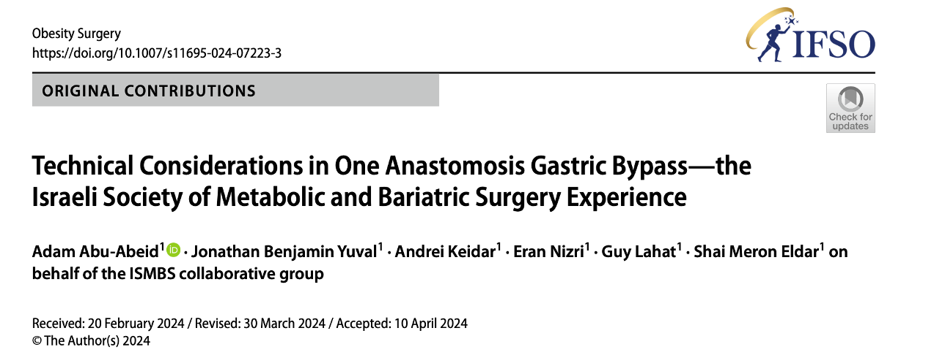

Online questionnaire for ISMBS members
75% response rate
Majority (80%) have more than 10 year experience
Majority (78.5%) perform OAGB most commonly

Slide 20
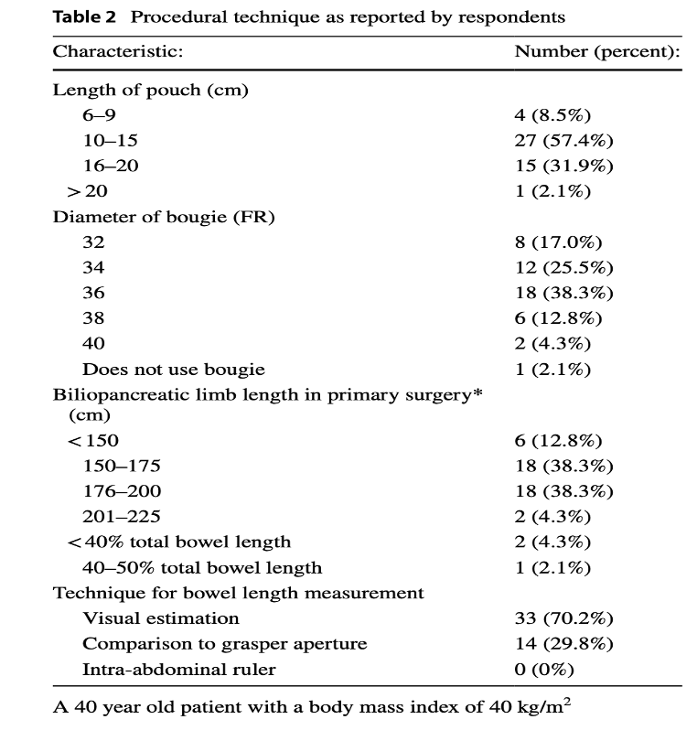
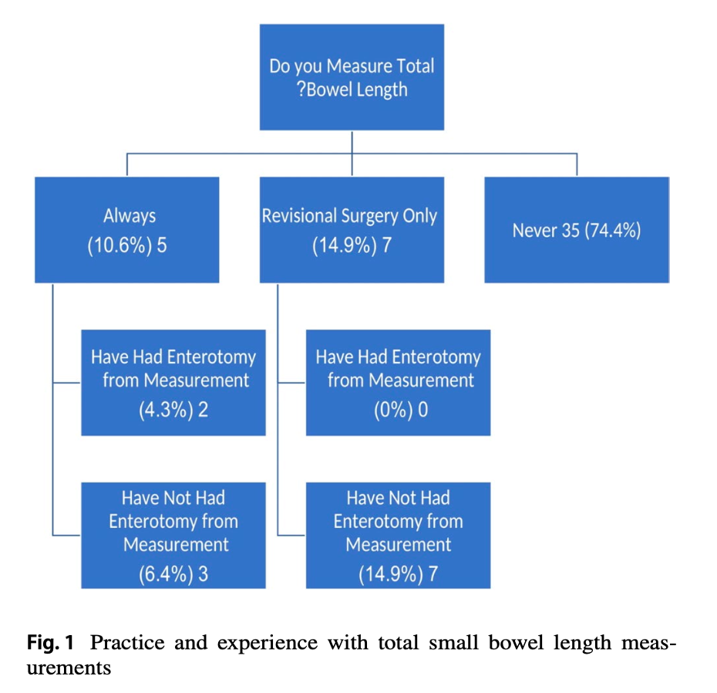
Abu-Abeid A et al. Technical Considerations in One Anastomosis Gastric Bypass-the Israeli Society of Metabolic and Bariatric Surgery Experience. Obes Surg. 2024

Slide 21
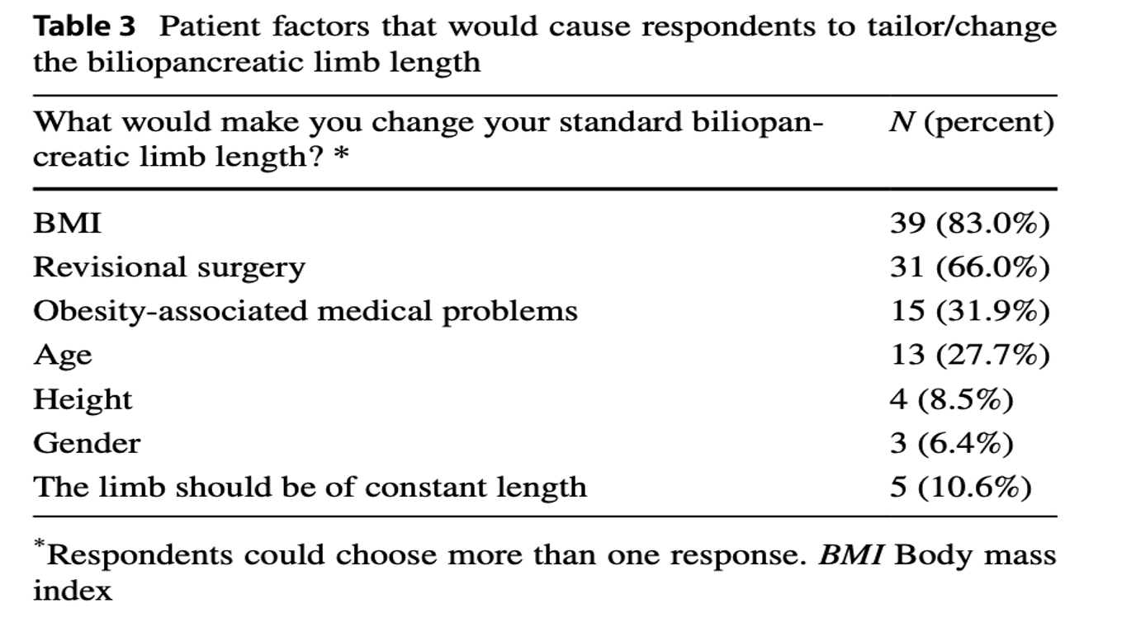
Abu-Abeid A et al. Technical Considerations in One Anastomosis Gastric Bypass-the Israeli Society of Metabolic and Bariatric Surgery Experience. Obes Surg. 2024

Slide 22

EFFECTIVENESS

Slide 23
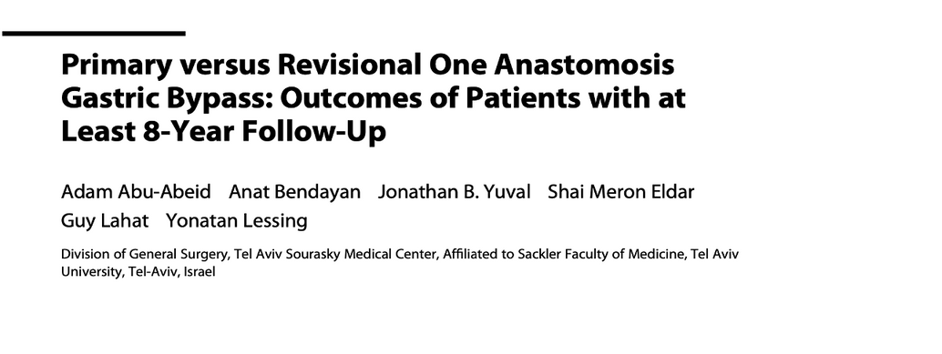
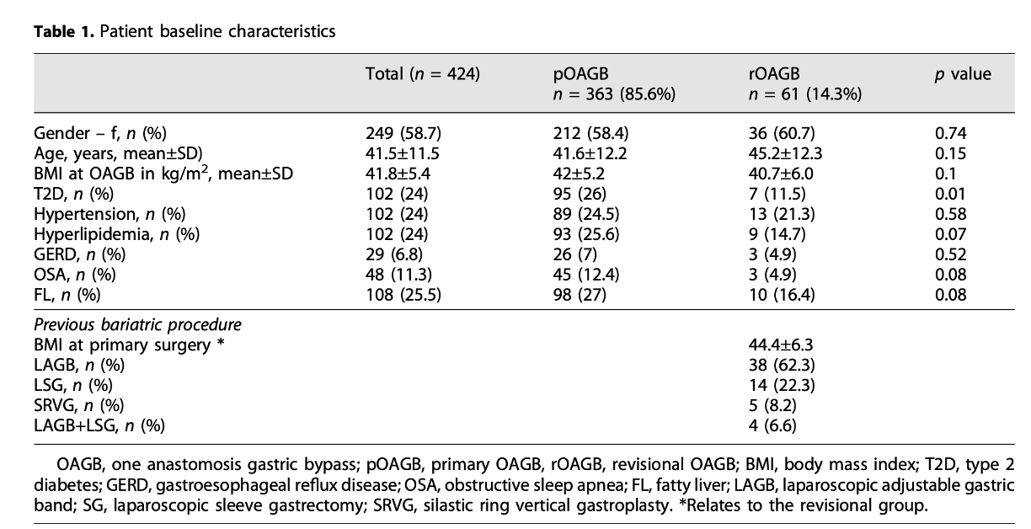
Obesity facts, 2024

Slide 24

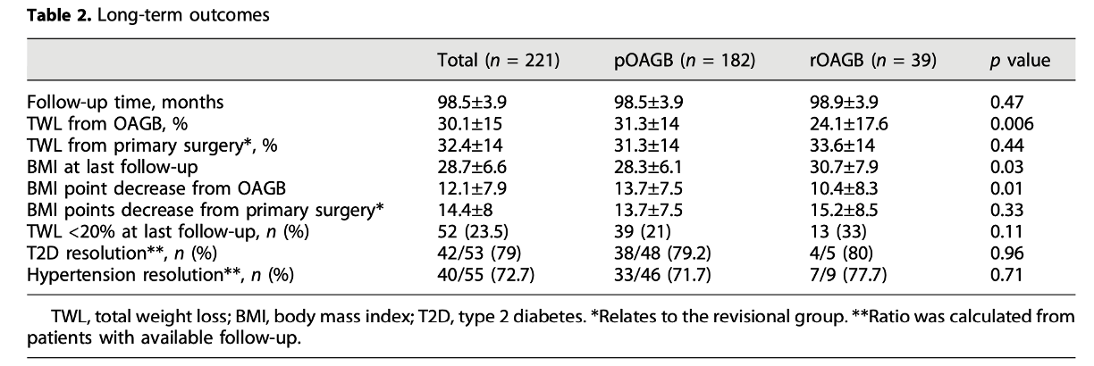
Obesity facts, 2024

Slide 25

Marginal Ulcers -Five patients (2.3%) underwent revisional surgery due to marginal ulcer perforation
Internal hernia - Two patients (0.9%) were diagnosed with an internal hernia during the follow-up.
Protein energy malnutrition - Two patients (0.9%) underwent OAGB reversal due to severe protein energy malnutrition.
Bile reflux- One patient (0.5%) underwent conversion to RYGB due to severe bile reflux
Anastomotic stricture - Two patients (0.9%) underwent conversion to RYGB due to gastro-jejunal anastomotic stricture
Other surgeries – Cholecystectomy (n=12, 5%), ventral hernia (n=10, 4.5%), colectomy (n=3), diaphragmatic hernia (n=2), appendectomy (n=1), Adhesiolysis (n=1)
Obesity facts, 2024

Slide 26
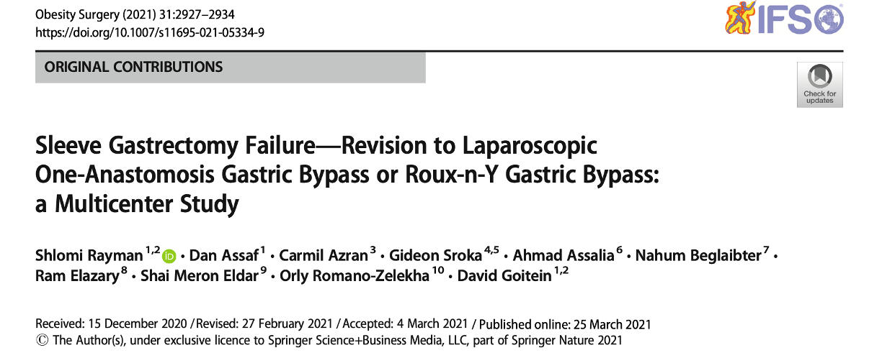
Multicenter cohort analysis (7 centers)
Patients underdoing conversion of SG to OAGB/RYGB due to WR/IWL
396 patients

Slide 27
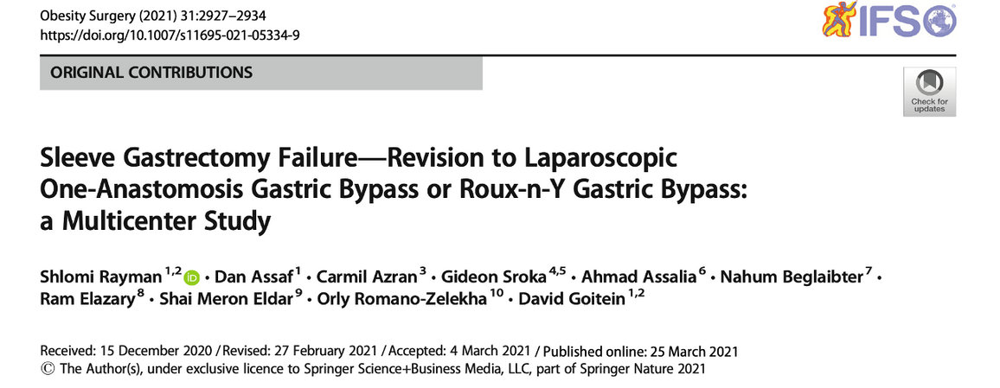
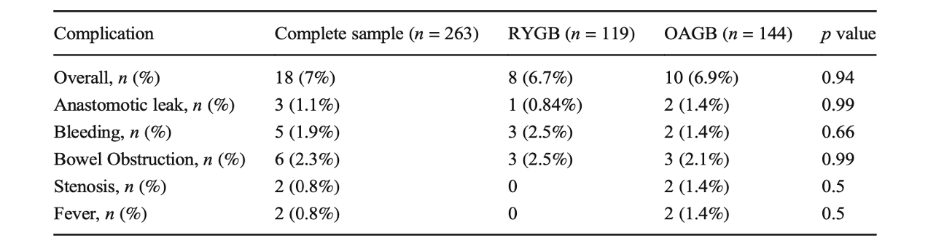

Slide 28
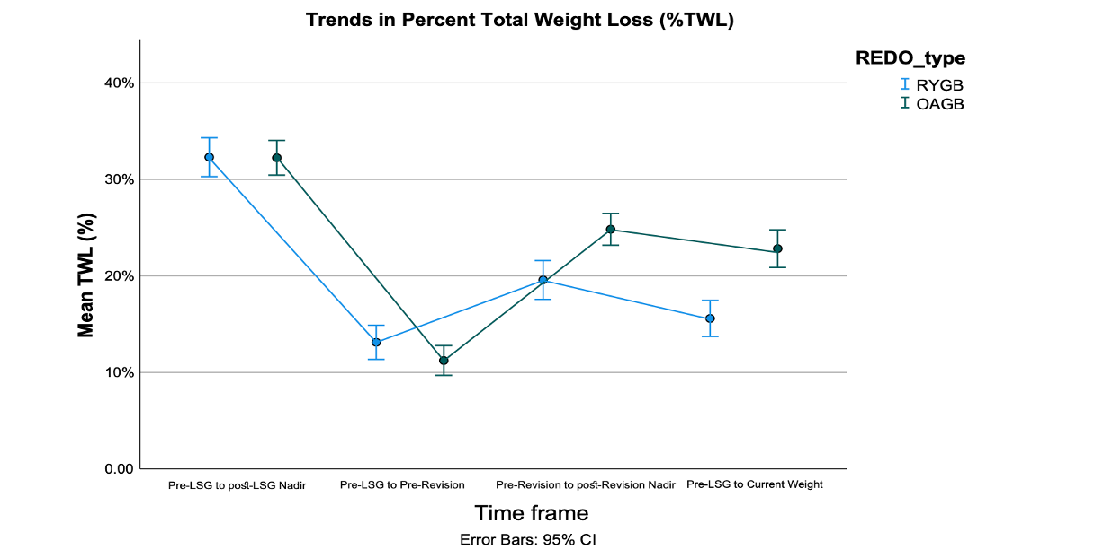
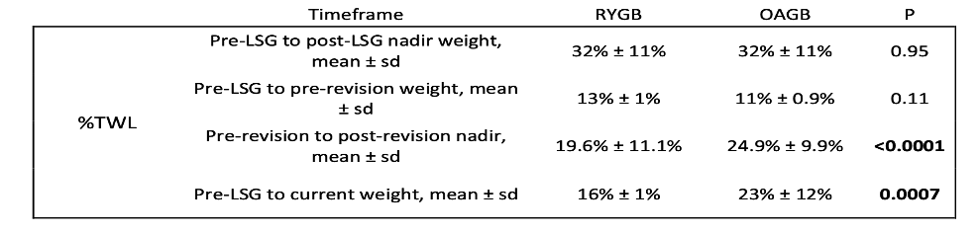
Rayman S et al. Sleeve Gastrectomy Failure-Revision to Laparoscopic One-Anastomosis Gastric Bypass or Roux-n-Y Gastric Bypass: a Multicenter Study. Obes Surg. 2021

Slide 29
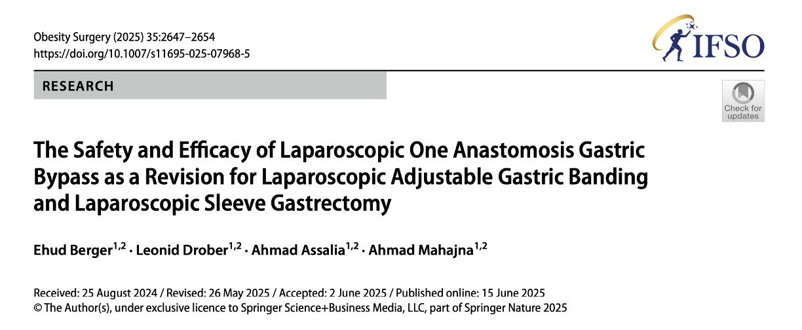
To assess the efficacy of OAGB after LAGB or SG
345 patients, 1 year follow-up

Slide 30
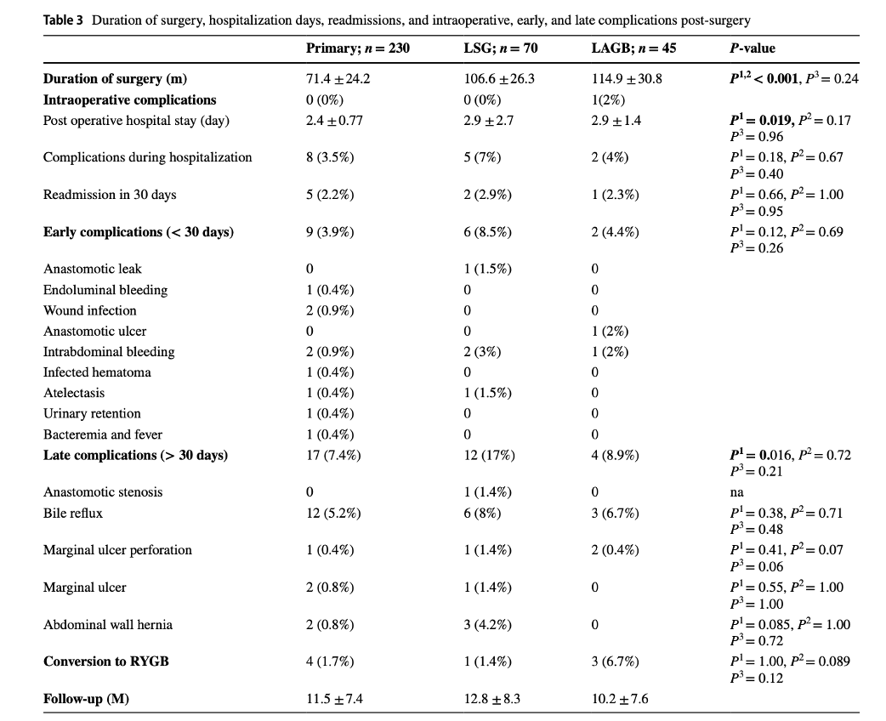
Berger E et al. The Safety and Efficacy of Laparoscopic One Anastomosis Gastric Bypass as a Revision for Laparoscopic Adjustable Gastric Banding and Laparoscopic Sleeve Gastrectomy. Obes Surg. 2025

Slide 31
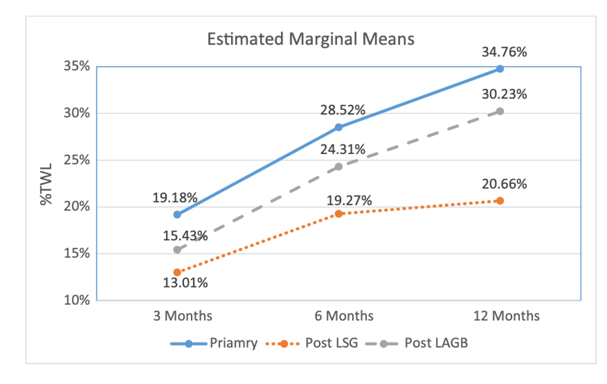
Berger E et al. The Safety and Efficacy of Laparoscopic One Anastomosis Gastric Bypass as a Revision for Laparoscopic Adjustable Gastric Banding and Laparoscopic Sleeve Gastrectomy. Obes Surg. 2025

Slide 32
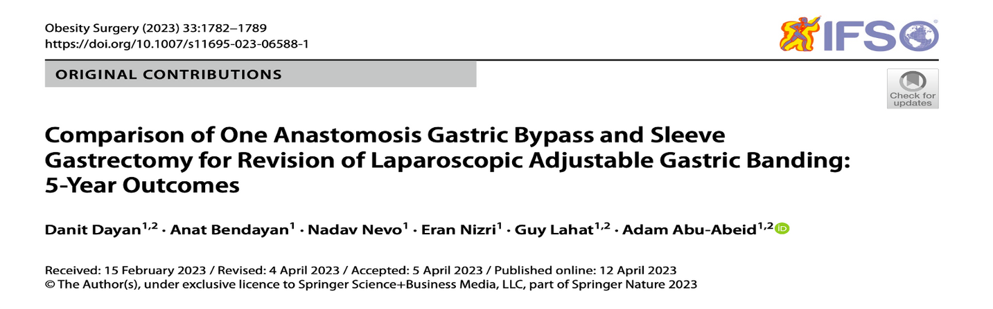
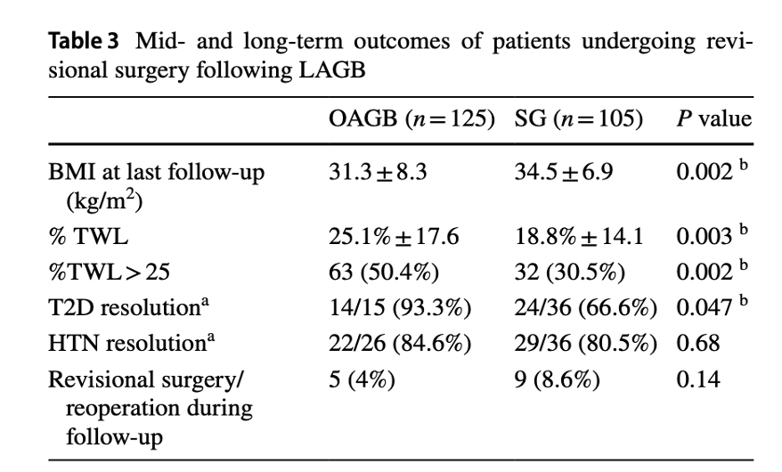
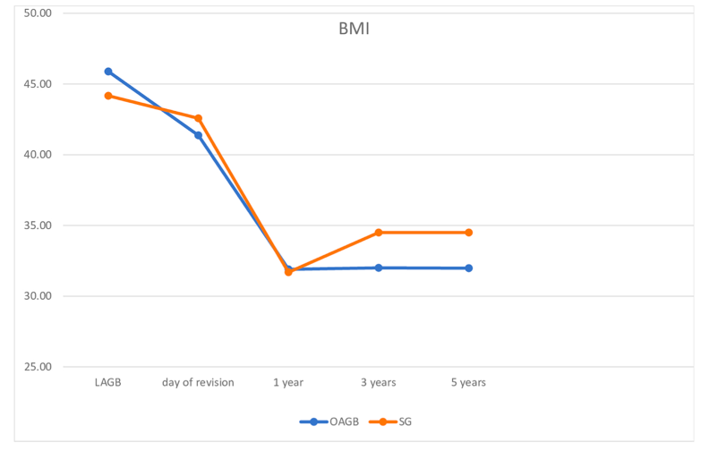

Slide 33

GERD, MARGINAL ULCERS, NUTRITION

Slide 34
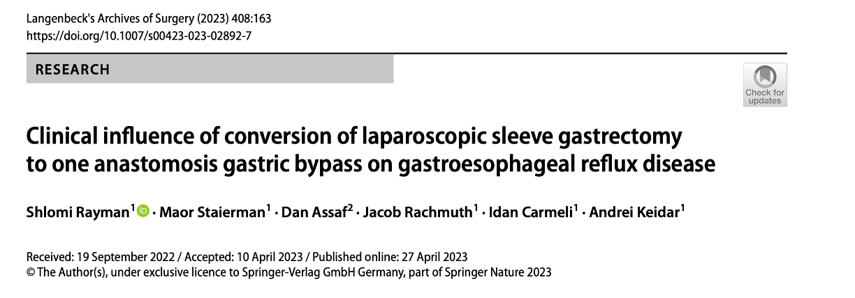
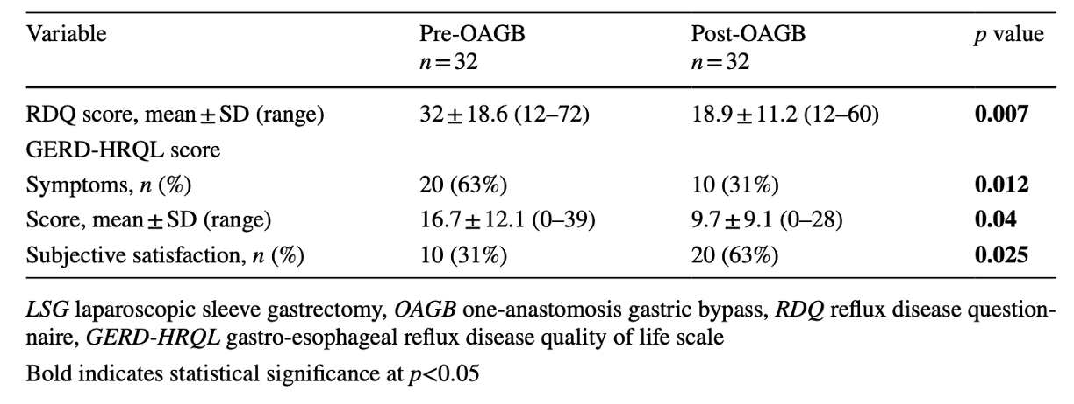

Slide 35
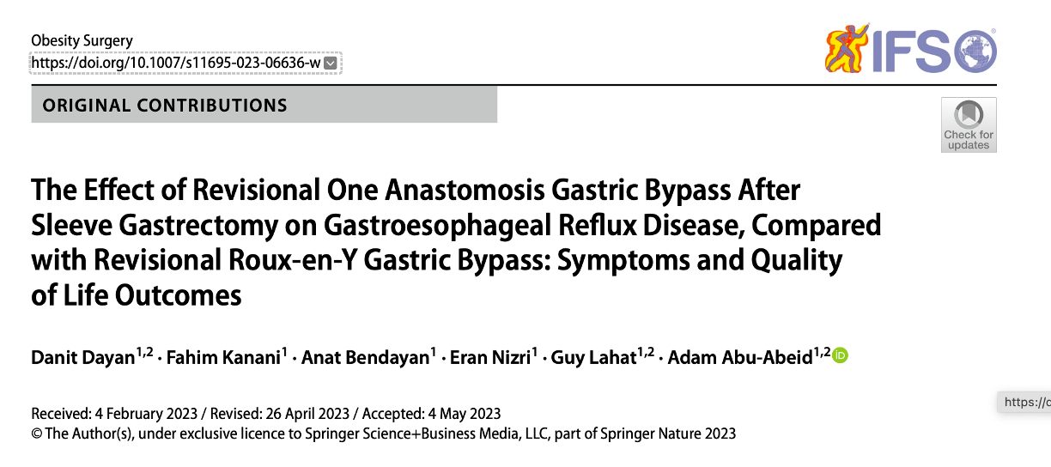
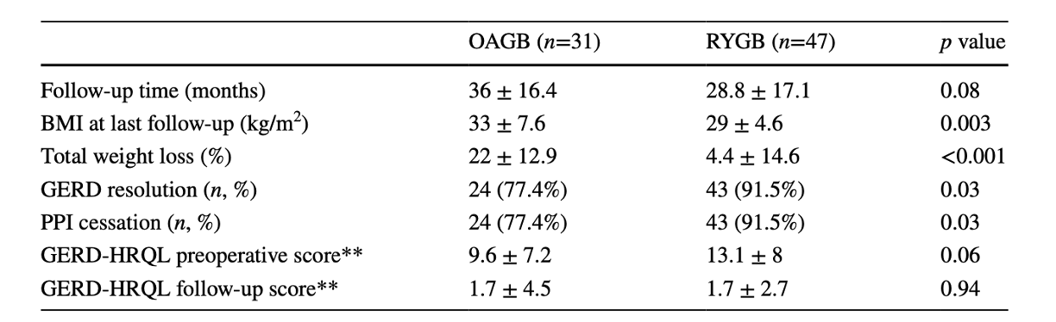

Slide 36
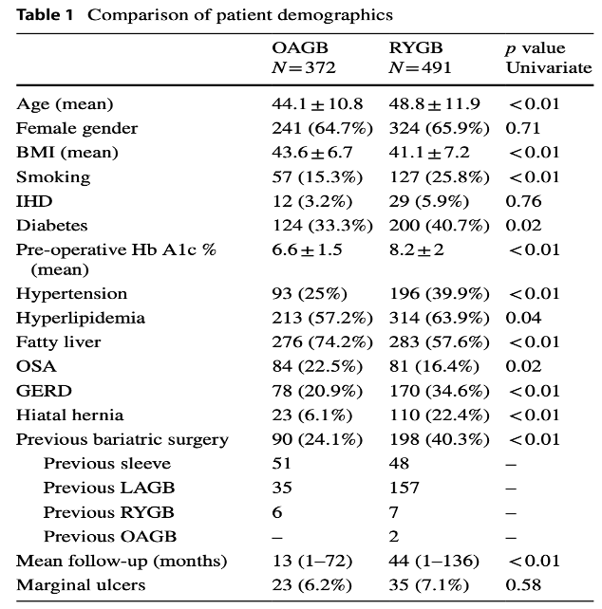
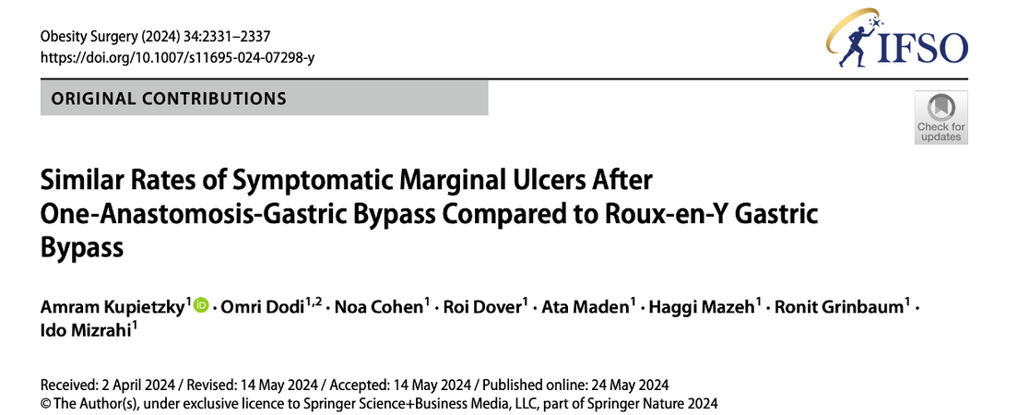

Slide 37
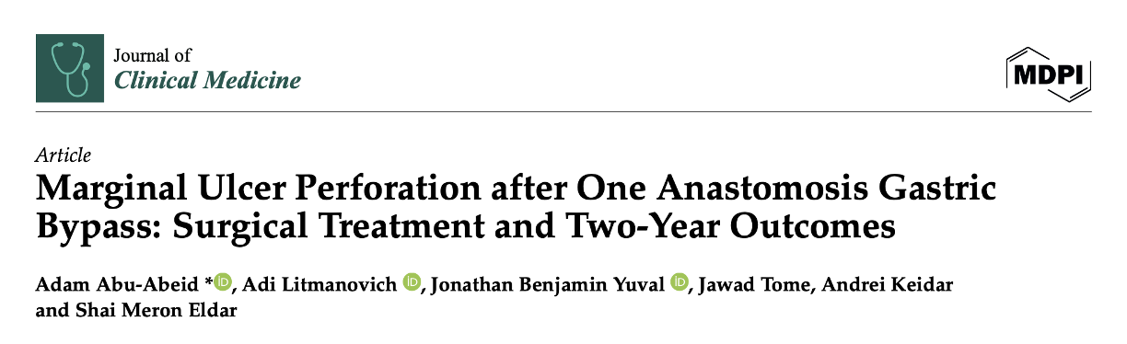
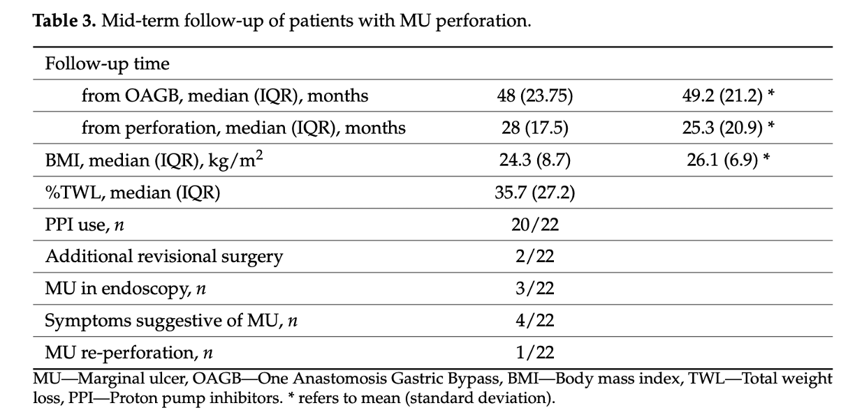

Slide 38
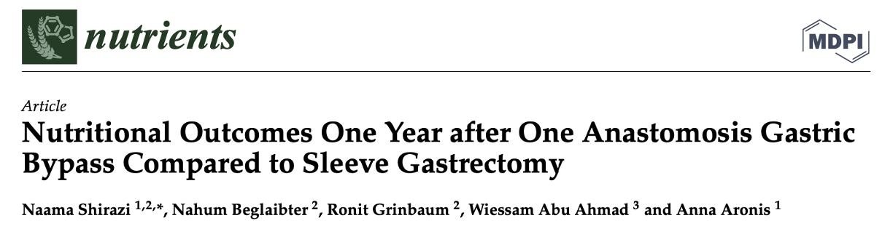
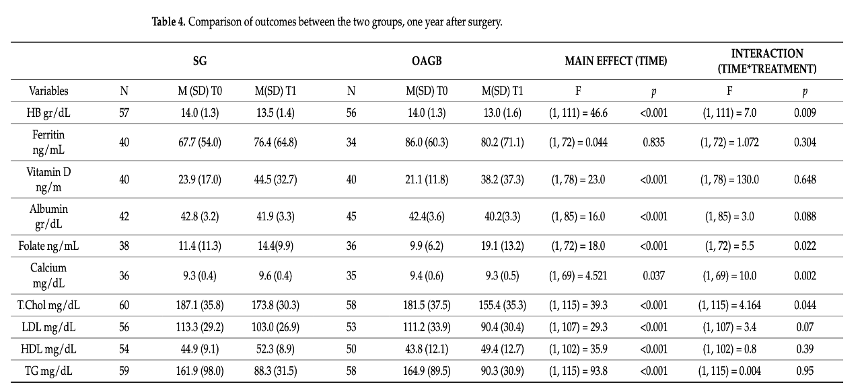
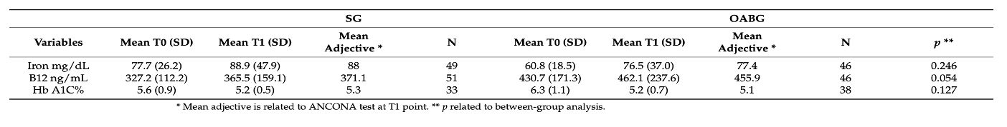

Slide 39

OAGB IN SPECIAL POPULATIONS

Slide 40
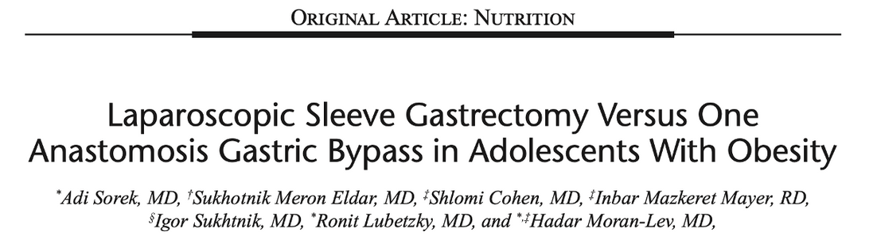
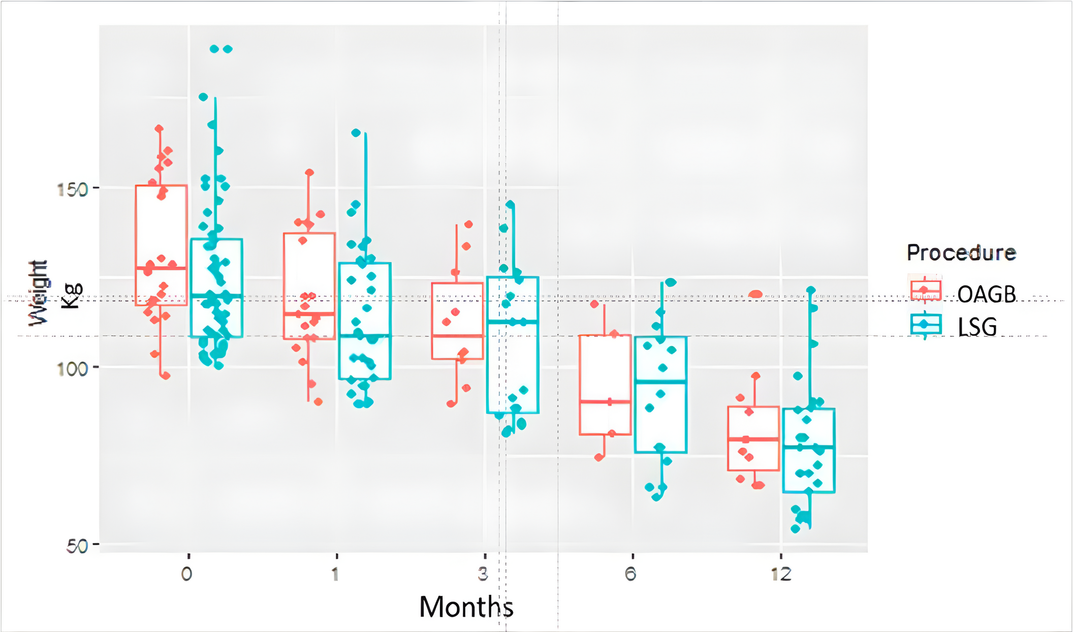
The results of the Pediatric Quality of Life Inventory Gastrointestinal Symptoms scale revealed significantly less food limitation and heartburn after OAGB compared to LSG (food limitation 71.63 vs 53.85 and heartburn 83.654 vs 61.6, P = 0.03 and P = 0.029, respectively).

Slide 41
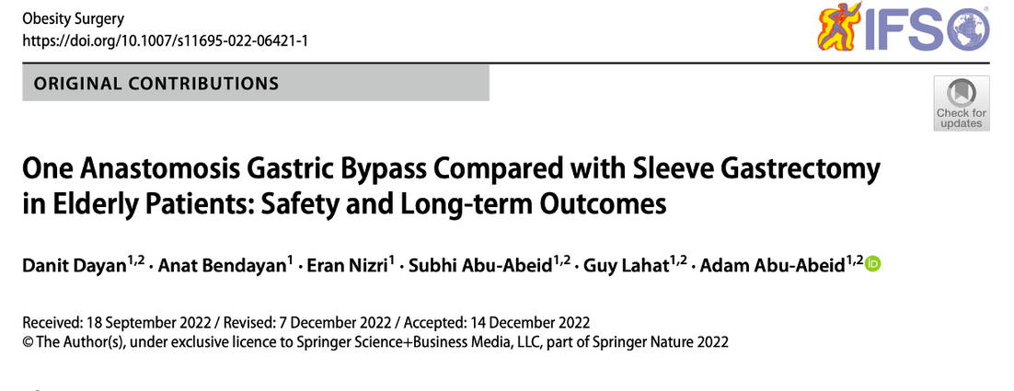
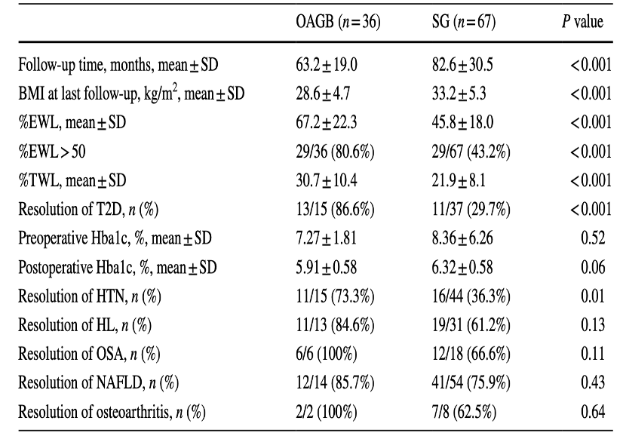
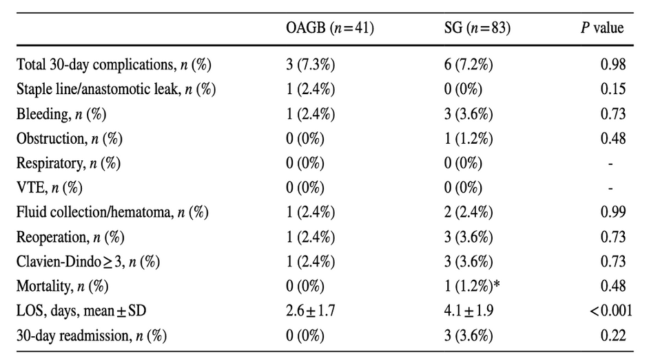

Slide 42
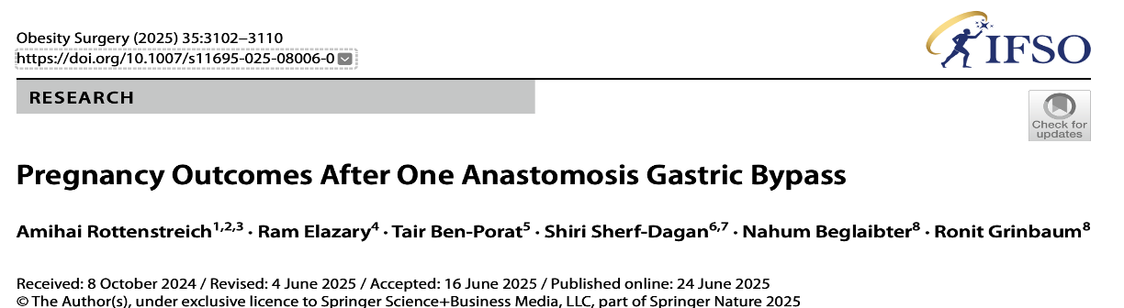


Slide 43


OAGB TAILORING

Slide 44



Slide 45


OAGB – shorter operative time, higher weight loss, no internal hernia

Slide 46



Slide 47


CONCLUSIONS
OAGB is the first procedure in Israel
And will continue to be for some time…
Perhaps will be more popular in some countries
Small country – good practices spread quickly

Slide 48


THANK YOU
Adam Abu Abeid, M.D
Division of Surgery, Tel Aviv Sourasky Medical Center
Assistant Professor, Gray’s Faculty of Medical Health and Sciences, Tel Aviv University
Email: adama@tlvmc.gov.il
Phone: +972524266283

